Slide 1

Lecture 8 Finding Shapes
COMP3204 Computer Vision
How can we group points to find shapes?
 | Book pp 225-239; 247-254

Slide 2
Content
How do we define and detect shapes in images?
How can we improve the detection process?

Slide 3
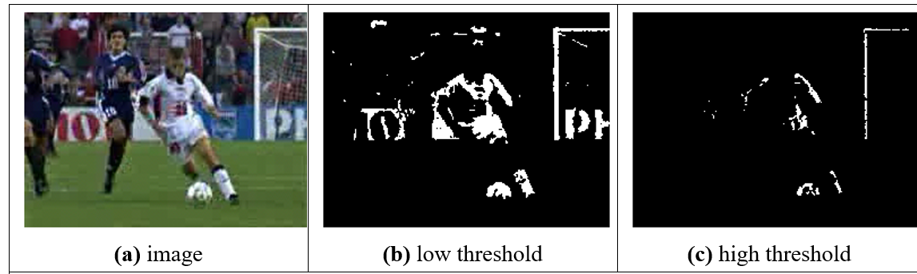

Feature extraction by thresholding
Conclusion: we need shape!

Slide 4
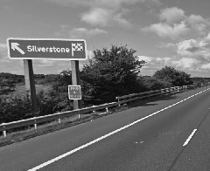

Template Matching -basis
Process of template matching
count of matching points
image
template
accumulator space
Suggestions for improving the process?
Use edges!

Slide 5
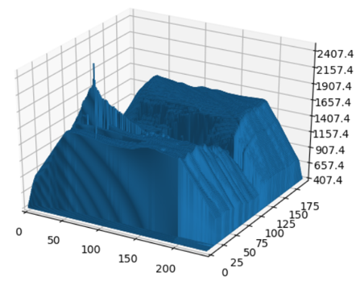

Template Matching
Intuitively simple
Correlation and convolution
Implementation via Fourier
Relationship with matched filter, viz: optimality
image
template
accumulator space

Slide 6
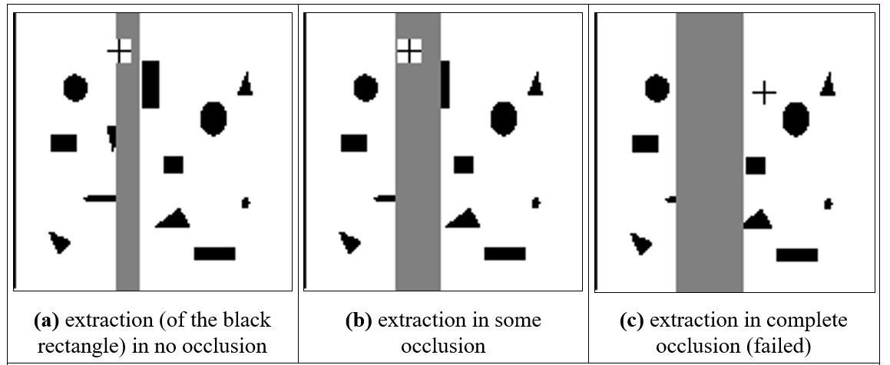
Template matching in occluded images
Template matching is optimal in occlusion

Slide 7
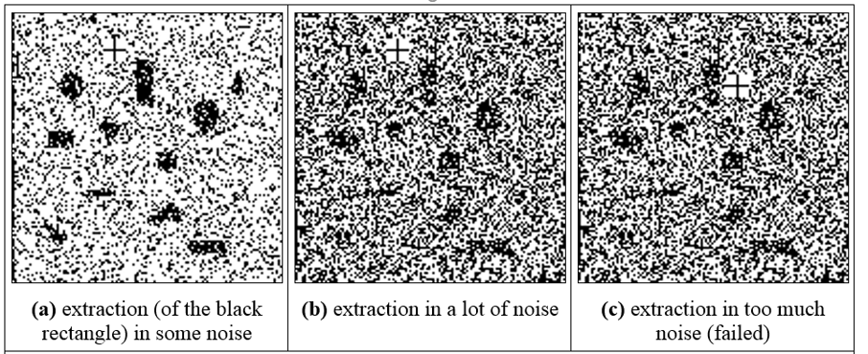
Template matching in noisy images
Template matching is optimal in noise
…but….

Slide 8
Convolution and correlation
Convolution is about application of a template

Slide 9

Convolution and correlation
Convolution is about application of a template
and involves flipping the template $I∗T=\sum_{\left(x,y\right)∈W}{I_{x,y}T_{x−i,y−j}}$

Slide 10

Convolution and correlation
Beware centring with transforms
Convolution is about application of a template
and involves flipping the template $I∗T=\sum_{\left(x,y\right)∈W}{I_{x,y}T_{x−i,y−j}}$
or by multiplying the transforms $I∗T=F^{−1}\left(F\left(I\right).×F(T)\right)$

Slide 11
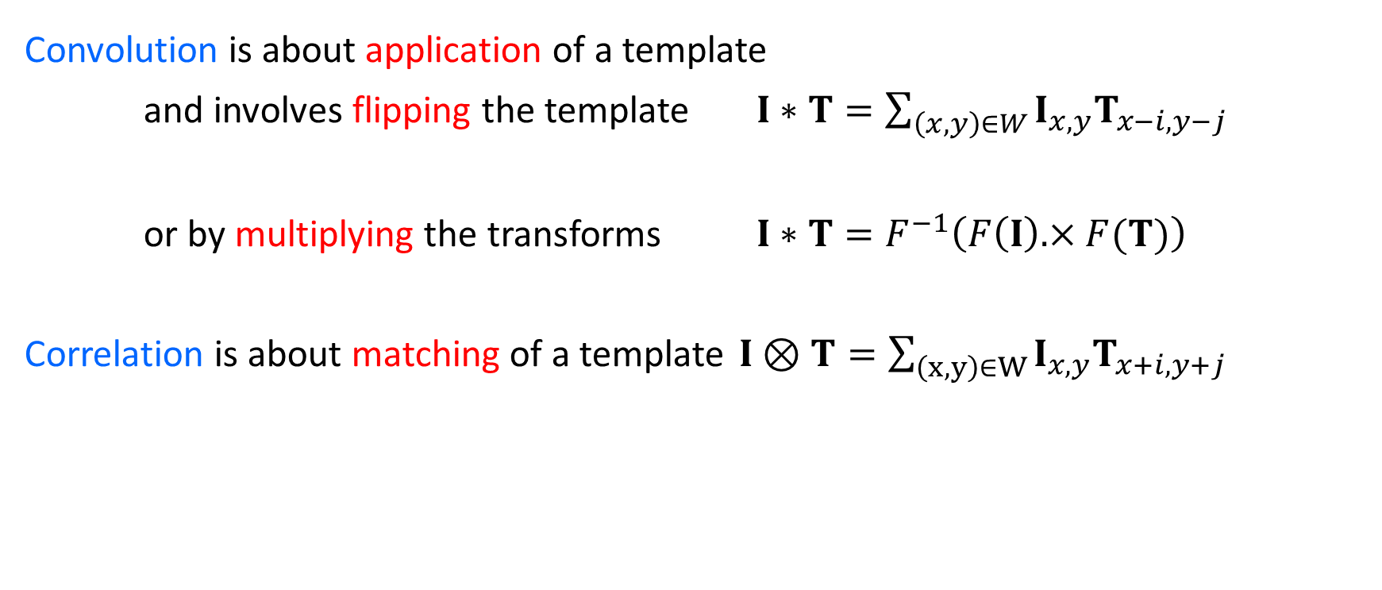
Convolution and correlation
Beware centring with transforms
Convolution is about application of a template
and involves flipping the template $I∗T=\sum_{\left(x,y\right)∈W}{I_{x,y}T_{x−i,y−j}}$
or by multiplying the transforms $I∗T=F^{−1}\left(F\left(I\right).×F(T)\right)$
Correlation is about matching of a template $I⊗T=\sum_{\left(x,y\right)∈W}{I_{x,y}T_{x+i,y+j}}$

Slide 12
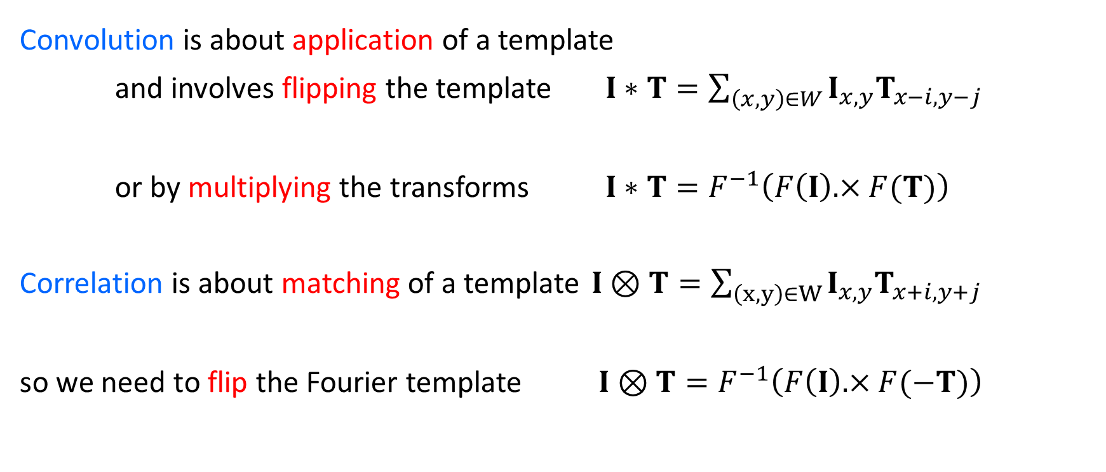
Convolution and correlation
Beware centring with transforms
Convolution is about application of a template
and involves flipping the template $I∗T=\sum_{\left(x,y\right)∈W}{I_{x,y}T_{x−i,y−j}}$
or by multiplying the transforms $I∗T=F^{−1}\left(F\left(I\right).×F(T)\right)$
Correlation is about matching of a template $I⊗T=\sum_{\left(x,y\right)∈W}{I_{x,y}T_{x+i,y+j}}$
so we need to flip the Fourier template $I⊗T=F^{−1}\left(F\left(I\right).×F(−T)\right)$

Slide 13
Convolution and correlation
Beware centring with transforms
Convolution is about application of a template
and involves flipping the template $I∗T=\sum_{\left(x,y\right)∈W}{I_{x,y}T_{x−i,y−j}}$
or by multiplying the transforms $I∗T=F^{−1}\left(F\left(I\right).×F(T)\right)$
Correlation is about matching of a template $I⊗T=\sum_{\left(x,y\right)∈W}{I_{x,y}T_{x+i,y+j}}$
so we need to flip the Fourier template $I⊗T=F^{−1}\left(F\left(I\right).×F(−T)\right)$
Jon needs this!!

Slide 14
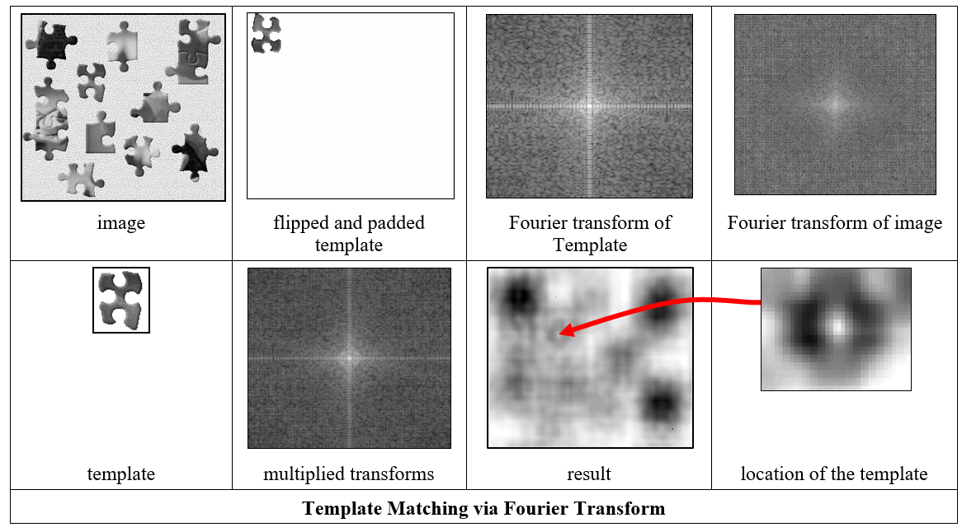
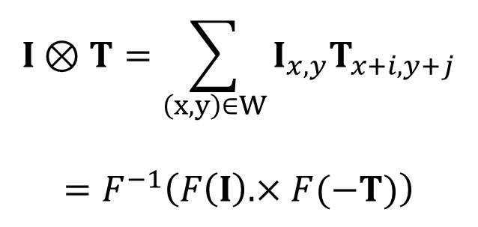
Encore, Baron Fourier!
Template matching is slow, so use FFT
$$I⊗T=\sum_{\left(x,y\right)∈W}{I_{x,y}T_{x+i,y+j}}$$
$$=F^{−1}\left(F\left(I\right).×F(−T)\right)$$
No sliding of templates here;
Cost is 2×FFT plus multiplication

Slide 15
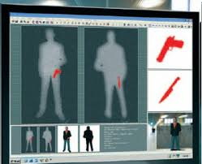
Applying template matching

Slide 16
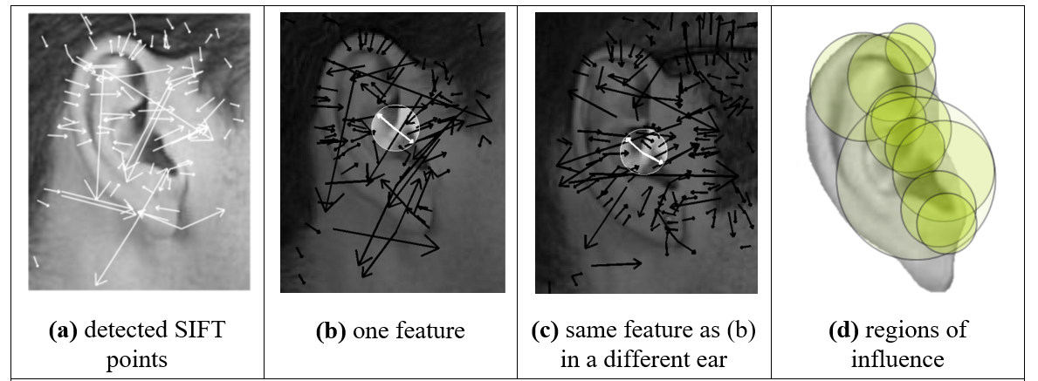
Applying SIFT in ear biometrics
Over to Jon Hare!

Slide 17
Hough Transform
Performance same as template matching, but faster

Slide 18
Hough Transform
Performance same as template matching, but faster
A line is points x,y gradient m intercept c

Slide 19
Hough Transform
Performance same as template matching, but faster
A line is points x,y gradient m intercept c
and is points m,c gradient -x intercept y

Slide 20
Hough Transform
Performance same as template matching, but faster
A line is points x,y gradient m intercept c
and is points m,c gradient -x intercept y
x
m
y
c
image
accumulator space

Slide 21
Hough Transform
Performance same as template matching, but faster
A line is points x,y gradient m intercept c
and is points m,c gradient -x intercept y
x
m
y
c
image
accumulator space
The coordinates of the peak are the parameters of the line

Slide 22
Hough Transform
Performance same as template matching, but faster
A line is points x,y gradient m intercept c
and is points m,c gradient -x intercept y
In maths it’s the principle of duality
x
m
y
c
image
accumulator space
The coordinates of the peak are the parameters of the line

Slide 23
Pseudocode for HT
accum=0
for all x,y !look at all points
if edge(y,x)>threshold !check significance
for m=-10 to +10 !if so, go thru m
c=-x*m+y !calculate c
accum(m,c) PLUS 1 !vote in accumulator
m,c = argmax(accum) !peak gives parameters

Slide 24
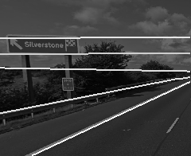
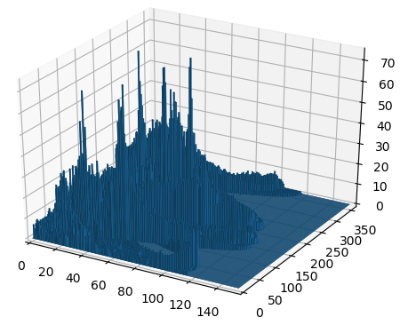
Applying the Hough transform for lines
image
detected lines
accumulator space
OK, it works. Can anyone see a problem?

Slide 25
Hough Transform for Lines … problems
m,c tend to infinity
Change the parameterisation
Use foot of normal
Gives polar HT for lines
Image containing line

Slide 26
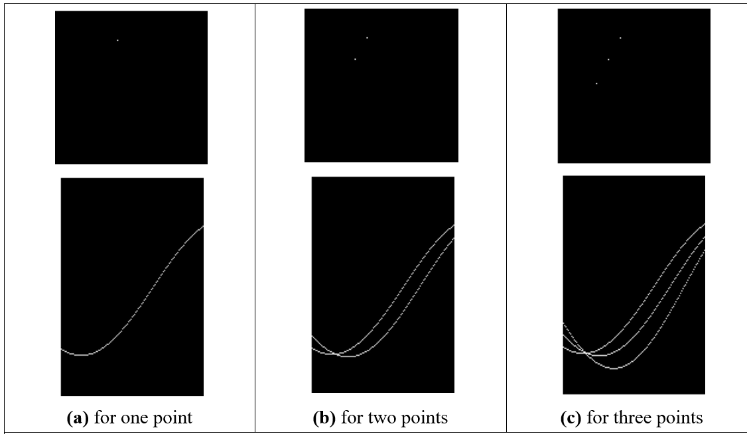
Images and the accumulator space of the polar Hough transform

Slide 27
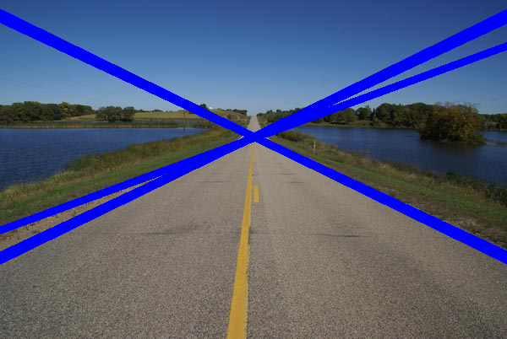
Applying the Hough transform

Slide 28
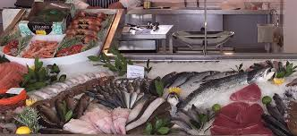
Takeaway time
1 – target shape defined by template
2 – and detected by template convolution
3 – optimal in occlusion and noise
4 – Hough transform gives same result, but faster
But shapes can be more complex than lines and not defined by an equations. That’s next
Notes:
J&S fish

